Slide 1


2
Data Types
and
Expressions
C# Programming: From Problem Analysis to Program Design
3rd Edition

Slide 2
Chapter Outline
Primitive Data Types
Constants
Reserved Words in C#
Identifiers
Reference Types
Operations and Operators
Formatting Output

Slide 3
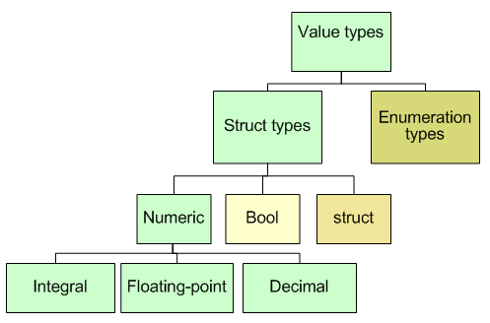
1. Primitive Data Types
Notes:
.NET framework includes a common type system (CTS)
-value types (Primitive data types) –contain their own copy of data, data is stored in the actual memory cell
-reference types - contain the address or location in which the sequence of bits is stored.

Slide 4
Integral Data Types
Includes following types:
byte & sbyte
char
int & uint
long & ulong
short & ushort

Slide 5
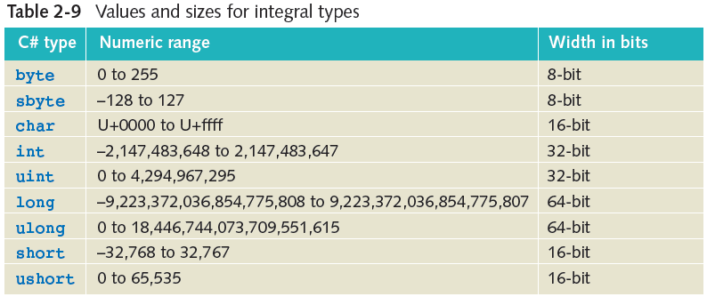
Integral Data Types

Slide 6

Character Data Type
Unicode – character set used by C#
Uses 16 bits to represent characters
2¹⁶, or 65,536 unique characters, can be represented
American Standard Code for Information Interchange (ASCII) – subset of Unicode
First 128 characters are the same

Slide 7
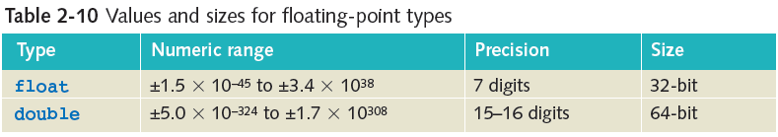
Floating-Point Data Types
May be in scientific notation with an exponent
3.2e+5 is equivalent to 320,000
1.76e-3 is equivalent to .00176
Default type is double
float type value must be followed with letter f or F, e.g 23.57f

Slide 8
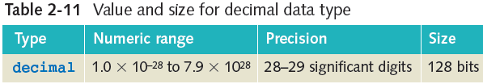
Decimal Data Type
Monetary data items
As with the float, must attach the suffix ‘m’ or ‘M’ onto the end of a number e.g. 33897698.26M

Slide 9
Boolean Data Type
Based on true/false, on/off logic
Boolean type in C# → bool
Boolean type values are true and false

Slide 10
2. Constants
Add the keyword const to a declaration
Value cannot be changed
Naming convention – use uppercase letters for identifiers
Examples:
const double TAX_RATE = 0.0675;
const int SPEED = 70;
const char HIGHEST_GRADE = ‘A’;

Slide 11
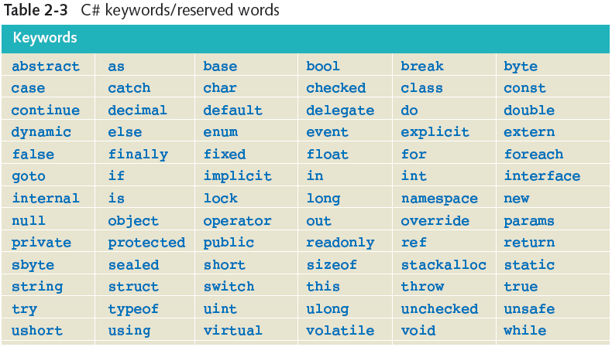
3. Reserved Words

Slide 12
4. Identifiers
Rules for creating an identifier
Combination of alphabetic characters (a-z and A-Z), numeric digits (0-9), and the underscore
First character in the name may not be numeric
No embedded spaces – concatenate (append) words together
Keywords cannot be used
Use the case of the character to your advantage
Be descriptive with meaningful names
Note: C# is case-sensitive so rate and Rate are different variables

Slide 13
Naming Conventions
Pascal case
First letter of each word capitalized
Used for class, method, namespace, and properties identifiers
Camel case
Hungarian notation
First letter of identifier lowercase; first letter of subsequent concatenated words capitalized
Used for variables and objects

Slide 14
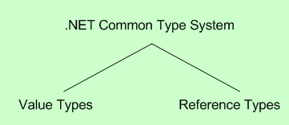
5. Reference Types
.NET Common Type System is divided into two major categories

Slide 15
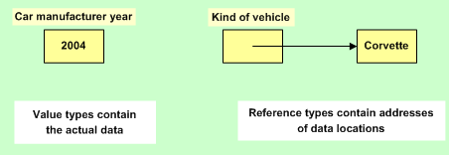
Value versus Reference Types

Slide 16
Strings
Reference type
Represents a string of Unicode characters
string studentName;
string courseName = “Programming I”;
string twoLines = “Line1\nLine2”;

Slide 17
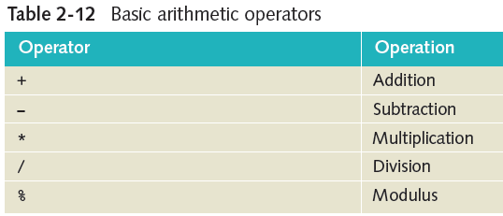
6. Operations and Operators

Slide 18
String Concatenation
Plus (+) with string Identifiers
Concatenates operand2 onto end of operand1
string fullName;
string firstName = “Rochelle”;
string lastName = “Howard”;
fullName = firstName + “ ” + lastName;

Slide 19
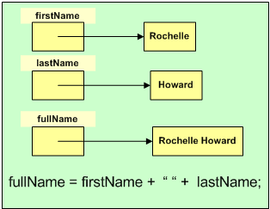
Concatenation

Slide 20
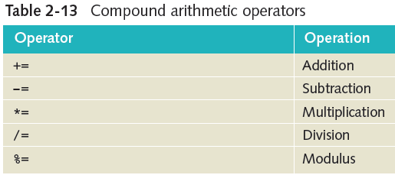
Compound Operations
Increment and Decrement Operators
++ and --

Slide 21
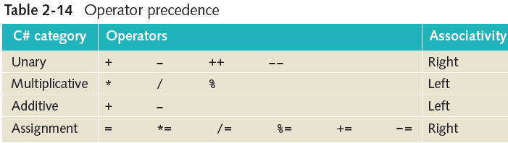
Order of Operations

Slide 22
Mixed Expressions
Explicit type coercion (casting)
(type) expression
Example:
average = (exam1 + exam2)/(double)count;

Slide 23
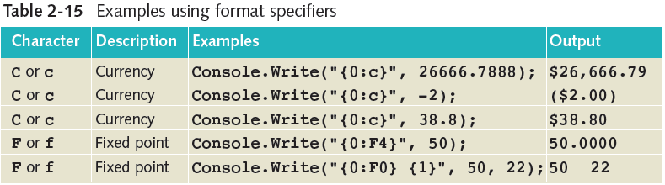
Formatting Output
Can use format specifiers in Write() and WriteLine() methods
Example:
Console.WriteLine(“Sum = {0}”, result);
//displays ‘Sum = 5’ assuming result contains 5

